Slide 1
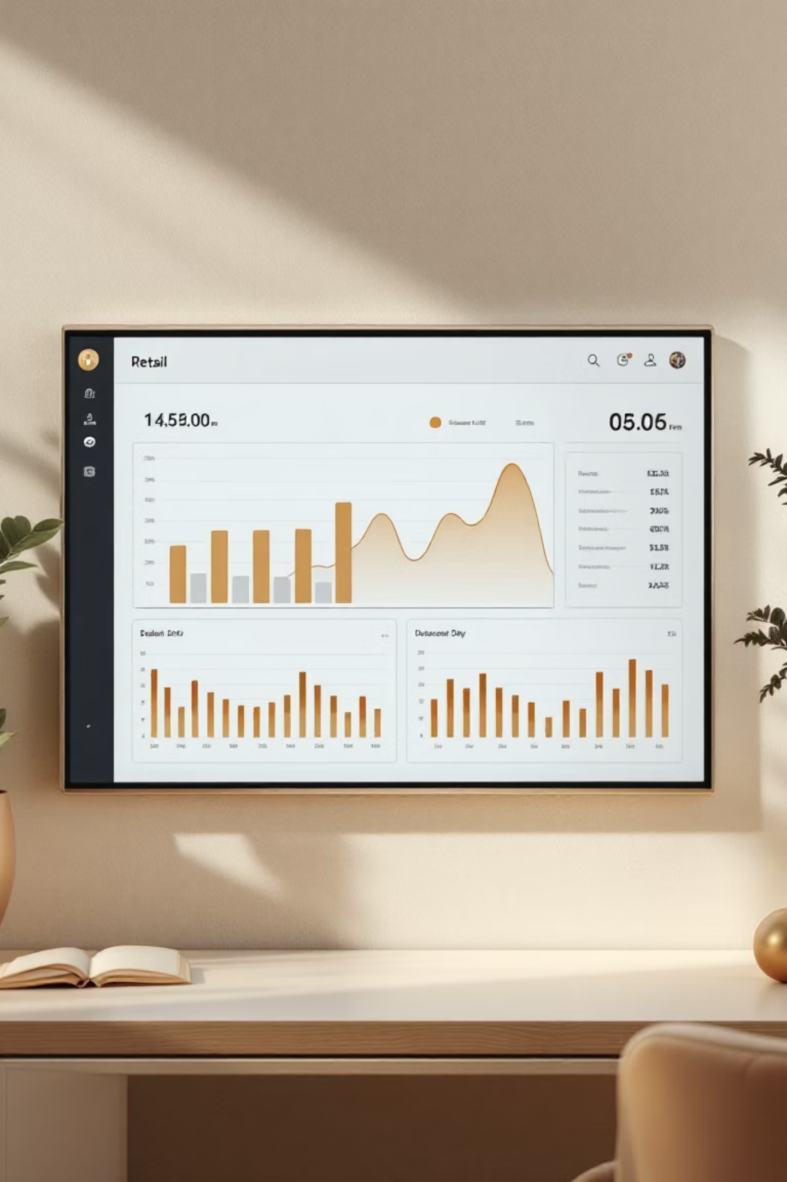
Customer Shopping Behavior Analysis
Leveraging consumer data to identify trends, improve engagement, and optimize marketing strategies

Slide 2




Business Challenge
Core Question
Changing Patterns
How can we leverage shopping data to improve sales and customer satisfaction?
Observed shifts across demographics, categories, and channels
Strategic Goal
Optimize marketing and product strategies for long-term loyalty

Slide 3

Dataset Overview
3,900
18
Total Records
Features
Customer transactions analyzed
Demographics, purchases, behaviors
37
Missing Values
Review ratings imputed by category median
Data Sources
customer_shopping_behavior.csv
Python analysis (Code.ipynb)
SQL queries for business insights
Power BI dashboard

Slide 4





Data Preparation Pipeline
Data Loading
Imported CSV with pandas, validated 3,900 records across 18 columns
Data Cleaning
Imputed missing review ratings using category-specific medians
Feature Engineering
Created age groups and converted purchase frequency to numeric days
Database Integration
Loaded into PostgreSQL via SQLAlchemy for SQL analysis

Slide 5
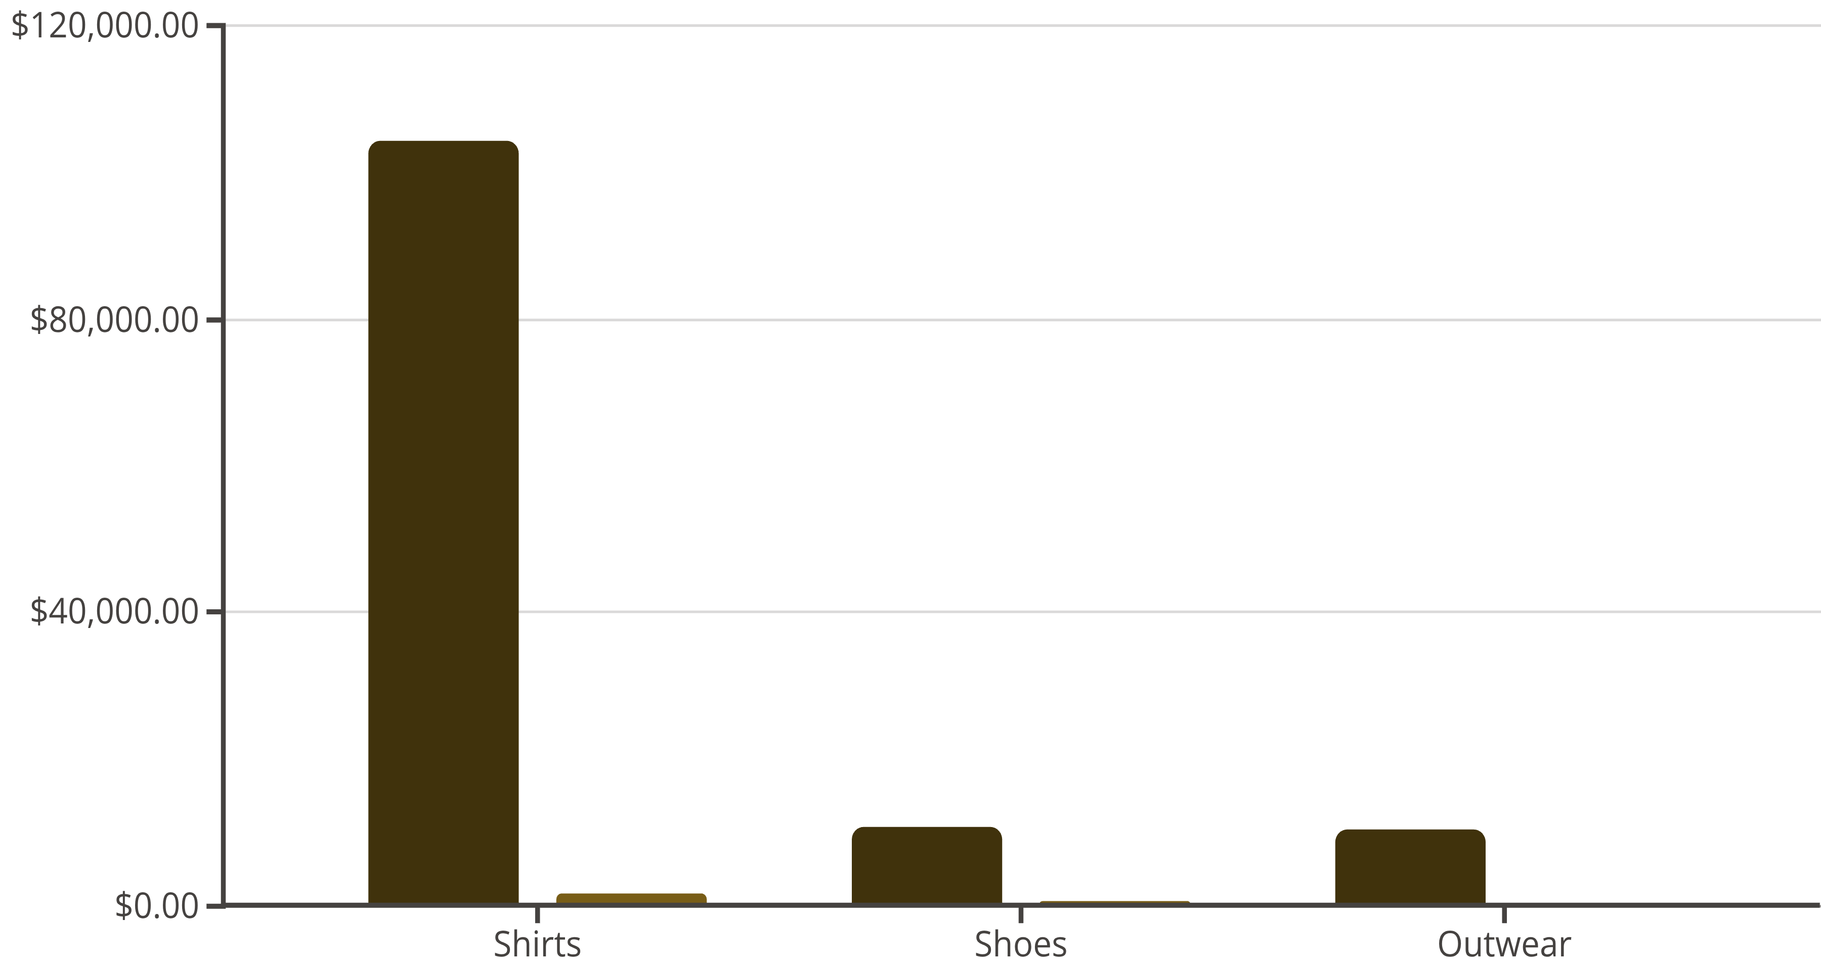
Revenue Performance Metrics
233K
$59.76
3.75
27%
Total Revenue
Avg Order Value
Avg Review Rating
Active Users
Across all customer segments
Per transaction
Customer satisfaction score
Engaged customer base
Revenue
Customers

Slide 6

Customer Segmentation Insights
New
2-10
10+
First-Time Buyers
Returning
Loyal
Repeat purchase range
Highest engagement tier
Single purchase customers
Loyal and returning customers generate majority of sales

Slide 7

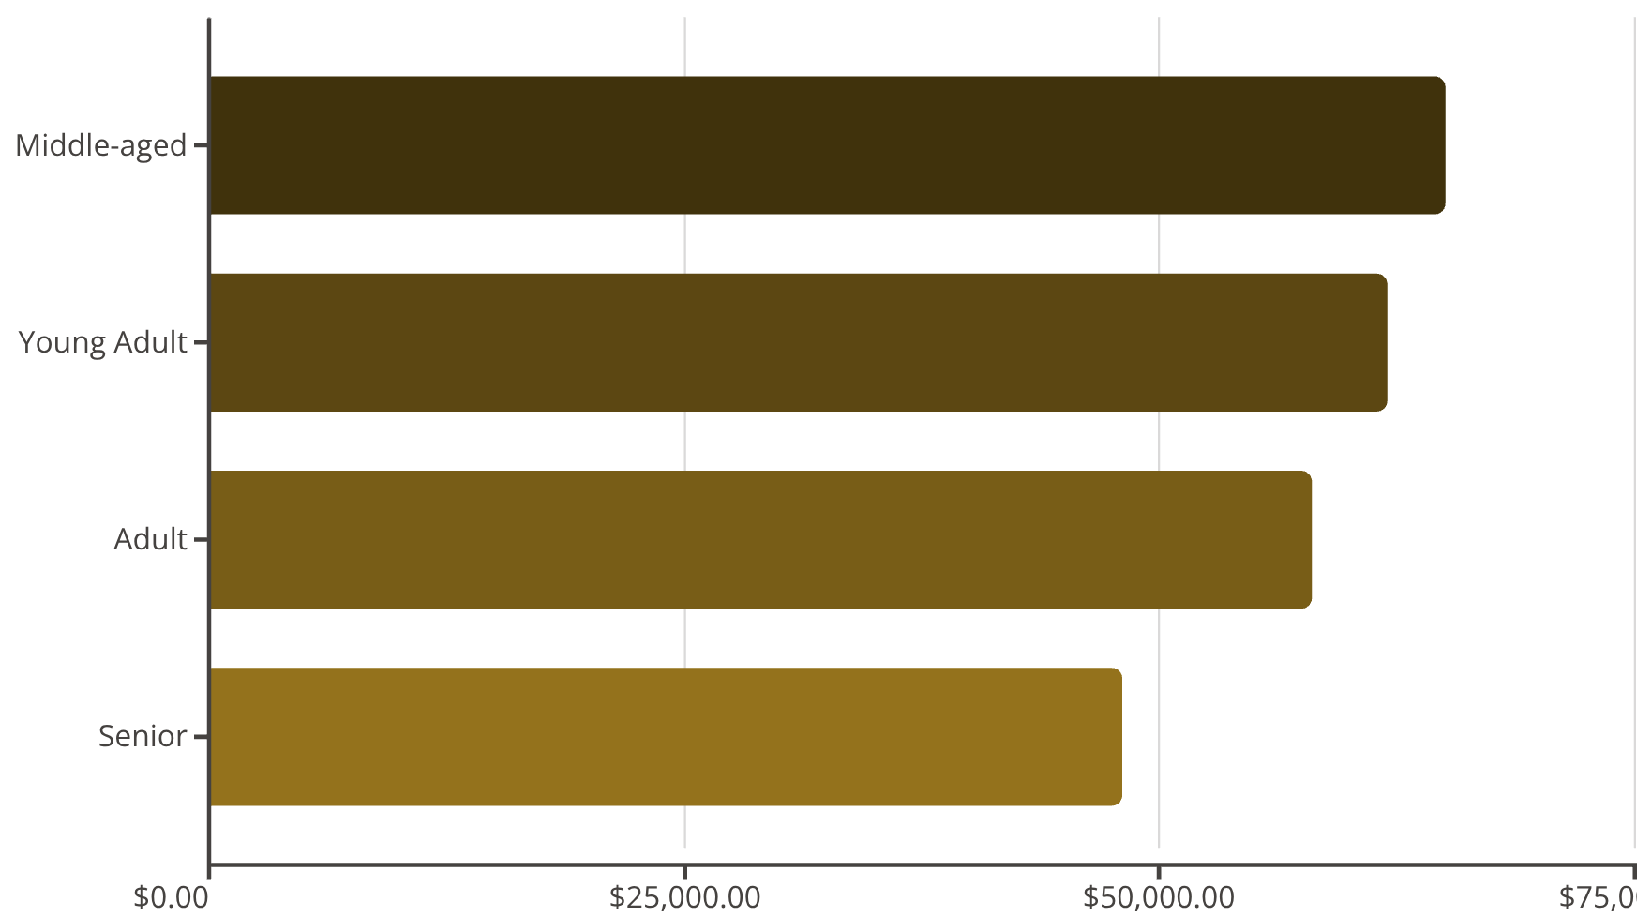

Customer Demographics & Revenue
Revenue by Gender
Revenue by Age Group
67.76%
Female
Dominant revenue contributor
32.24%
Male
Secondary segment

Slide 8

Subscription Impact
Subscribers
Higher average spend and stronger retention rates
Non-Subscribers
Lower engagement and purchase frequency
Subscribers demonstrate significantly higher lifetime value

Slide 9
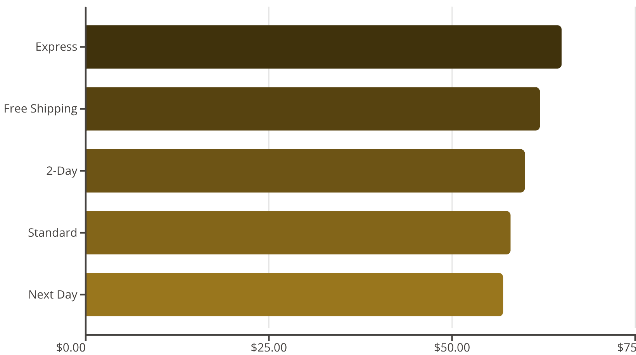
Shipping & Subscription Insights
Avg Purchase by Shipping Type
Subscription Impact
$64
$56
Subscribers
Non-Subscribers
Average spend
Average spend
Key Finding: Subscribers spend 14% more on average and show stronger retention patterns

Slide 10
Shipping & Demographics
Express Shipping
Age Groups
Free Shipping
Associated with higher purchase values
Middle-aged and young adults drive highest revenue
Popular option with strong conversion

Slide 11
Strategic Recommendations
01
02
03
Boost Subscription Adoption
Strengthen Loyalty Programs
Optimize Discount Strategy
Promote exclusive offers and benefits to convert non-subscribers
Focus discounts on high-margin products and loyal customer segments
Incentivize repeat purchases to convert returning customers into loyal advocates
04
05
Targeted Marketing
Product Promotion
Focus campaigns on high-revenue age groups and express shipping preferences
Highlight top-rated and best-selling items in marketing campaigns

Slide 12

End-to-End Analytics Success
1
Python Analysis
Data cleaning, feature engineering, exploratory analysis
2
SQL Insights
Business queries, segmentation, revenue analysis
3
Power BI Dashboards
Interactive visualizations, KPI tracking, drill-through views
4
Actionable Strategy
Data-driven recommendations for growth and profitability
"By integrating data preparation, business analysis, and visualization, we can make informed strategic decisions that drive growth, engagement, and profitability."

